Slide 1
Pneumonia Detection Using CNN
Presented By Guided By
Resika R S Prof. Natheera Beevi M
MCA23-149
8/11/2024

Slide 2
Introduction
Pneumonia is a serious respiratory infection affecting millions of people worldwide. Early detection and diagnosis are critical for effective treatment
This project develops an automated pneumonia detection system using CNN deep learning models Vgg16,Resnet50 and Inception v3
Models are trained on the Chest x ray images dataset to ensure the accuracy of the pneumonia identification and prediction

Slide 3
Problem Statement
Manual diagnosis of Pneumonia by radiologists is time-consuming and prone to human error.
Accurate pneumonia diagnosis often requires trained radiologists, who may not be readily available in all healthcare settings, especially in remote or under-resourced areas.
Goal is to develop an automated system using deep learning to detect pneumonia from chest X-ray images with high accuracy.
This system will provide accurate and scalable detection of pneumonia

Slide 4
Literature Review
Title/Author | Source | Algorithm | Year
A Deep Learning Based Model For the Detection of Pneumonia From chest Xray Images using VGG16 And Neural Networks. Shagun Sharma and Kalpna Guleria | Science Direct | Vgg16 | 2023
Pneumonia Detection Using CNN Mr Pramoth K M, Mr PrabhakarRaj Ravi and Mr Sajith S | IEEE | CNN, Vgg16 | 2022

Slide 5
Gaps Identified
While previous research effectively demonstrated the application of VGG16 combined with neural networks (NN) for pneumonia detection using chest X-rays (CXR) with substantial accuracy, the analysis was limited to a single deep learning model architecture.
To address this gap, our work expands on these findings by investigating the comparative performance of additional deep learning models, including ResNet50, VGG16, and InceptionV3, to identify optimal architectures for pneumonia detection.
Our experiments achieved improved performance, with VGG16 yielding the highest accuracy at 95.30%, closely followed by ResNet50 and InceptionV3, highlighting both the potential and limitations of different architectures in this critical application area."

Slide 6
Methodology
Dataset Preparation
Dataset: Kaggle Chest X-ray images,contains 5863 images labeled for pneumonia and healthy cases.
Preprocessing: Resize, normalize, and augment images to enhance model performance.
CNN Model Selection
VGG16: Simple, 16-layer architecture, effective for image classification.
ResNet-50: Deeper network using residual connections to improve learning.
Inception V3: Efficient multi-scale feature extraction for high accuracy.

Slide 7
Methodology
Model Training and Evaluation
Training: Train each model on a portion of the dataset with hyperparameter fine tuning.
Validation: Regular validation to prevent overfitting.
Metrics: Accuracy, precision, recall, F1-score
Testing and Deployment
Testing: Evaluate models on test data to determine best performer.
Deployment: Potential for integration into healthcare settings

Slide 8
Results
 | Resnet50 | VGG16 | Inception V3
Training Accuracy | 97.12% | 96.23% | 93.24%
Validation Accuracy | 95.11% | 95.30% | 91.94%

Slide 9
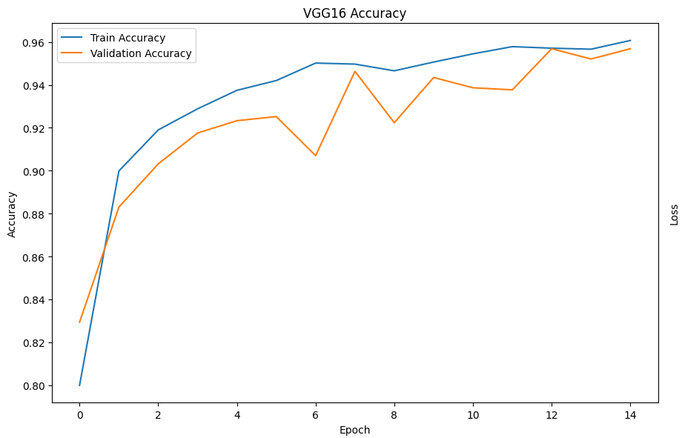
Evaluation Curve-VGG16

Slide 10
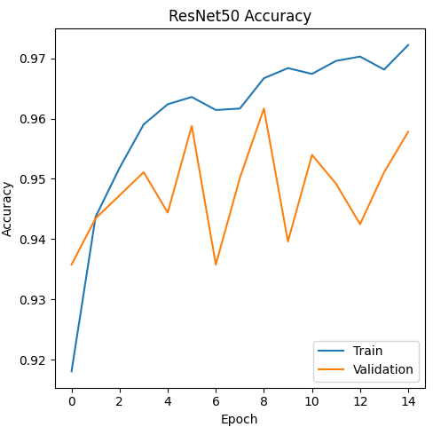
Evaluation Curve-Resnet50

Slide 11
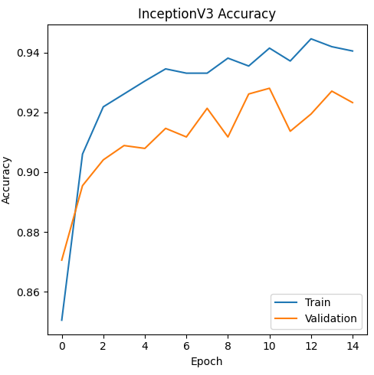
Evaluation Curve-Inception V3

Slide 12
Conclusion
Successful Detection: The CNN models effectively identified pneumonia from chest X-ray images, demonstrating the potential of deep learning in medical diagnosis.
Best Model: Among VGG16, ResNet-50, and Inception V3, Vgg-16 achieved the highest accuracy(95.30%), making it the most effective model for this task.
Impact: This automated detection approach can support healthcare professionals by providing faster, accurate diagnosis, especially in resource-limited settings.

Slide 13
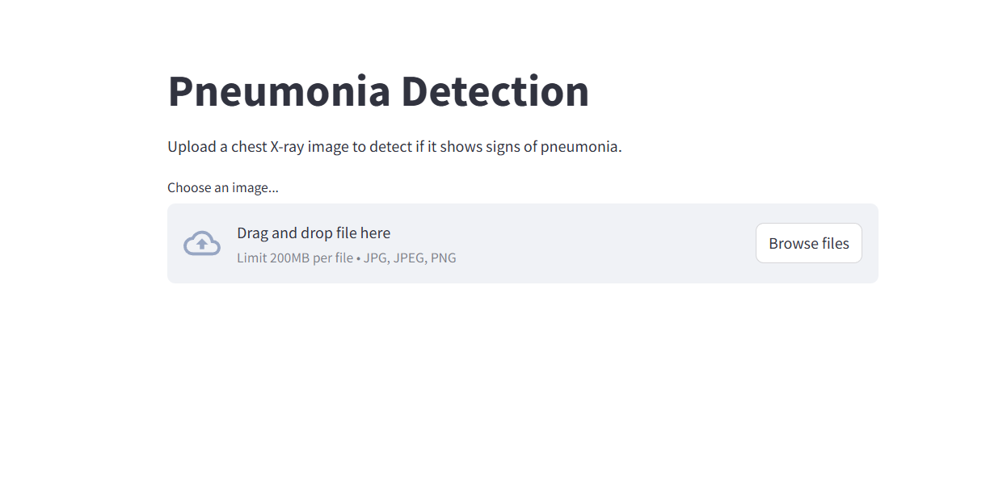
Demo Screenshots

Slide 14
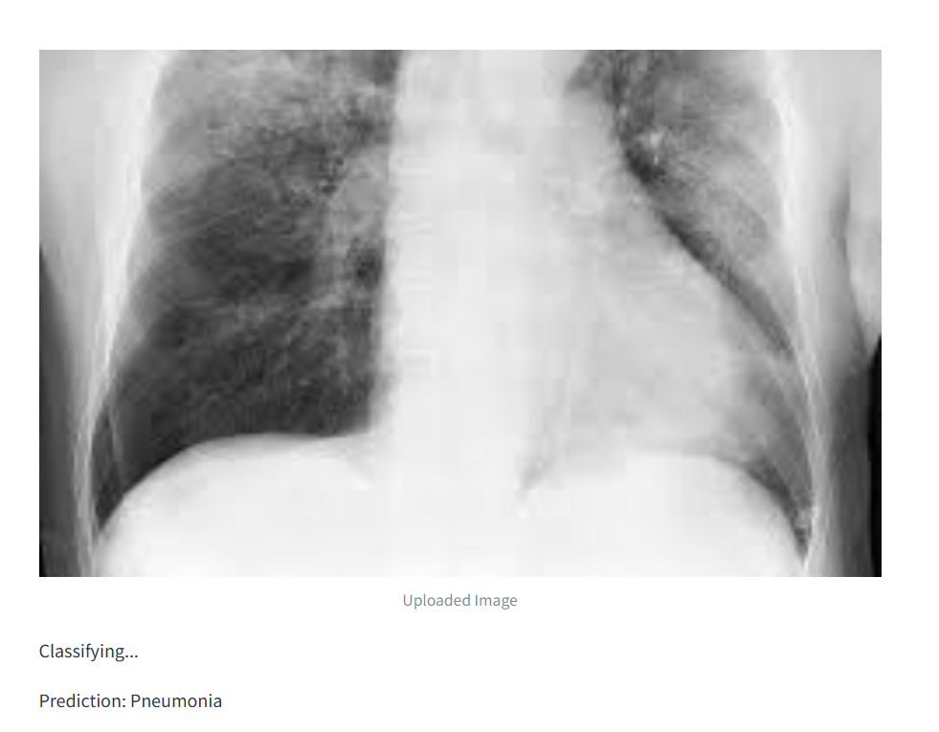

Slide 15
Future Enhancements
Real-time Detection
Implement real-time chest X-ray analysis for quick detection, reducing the time from diagnosis to treatment.
Multi-class Classification
Expand the model to classify different types of pneumonia (bacterial, viral, fungal) and other lung-related diseases.
Edge Device Deployment
Deploy the model on mobile or edge devices for accessibility in remote or underserved areas without internet access.

Slide 16
Future Enhancements
3D Imaging Integration
Integrate 3D chest X-ray or CT scan data for more accurate and detailed detection, especially for early-stage pneumonia.
AI-powered Augmented Diagnosis
Develop a system that integrates the pneumonia detection model with AI-driven suggestions for treatment plans and follow-up recommendations.

Slide 17
THANK YOU

